Slide 1
My Health Keeper
Team Aide
Siana Rizwan (180042105)
Farzana Tabassum (180042119)
Sabrina Islam (180042122)

Slide 2
My Health Keeper is a ONE STOP solution where users can store all sorts of health related information in ONE place

Slide 3
Features At A Glance…..
Storing General Health Information
Diet Plan
Storing Specialized Health Information
Report Analysis
Disease Prediction
Medicine Reminder
Menstrual Cycle Tracker

Slide 4
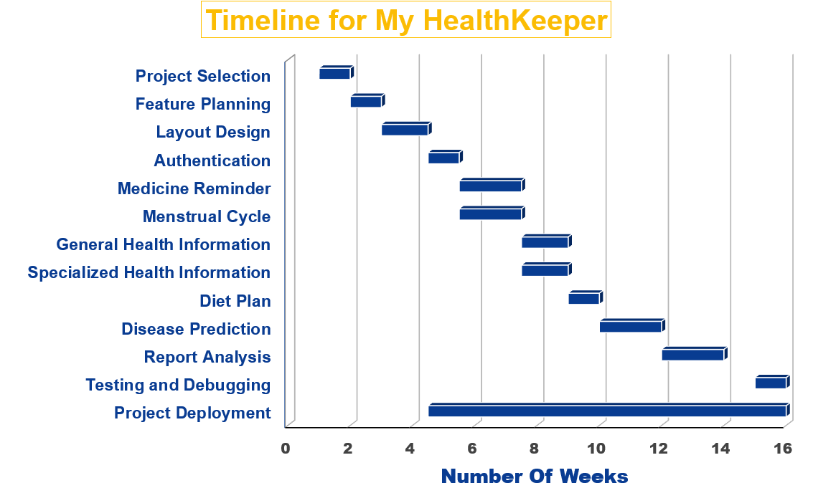

Slide 5
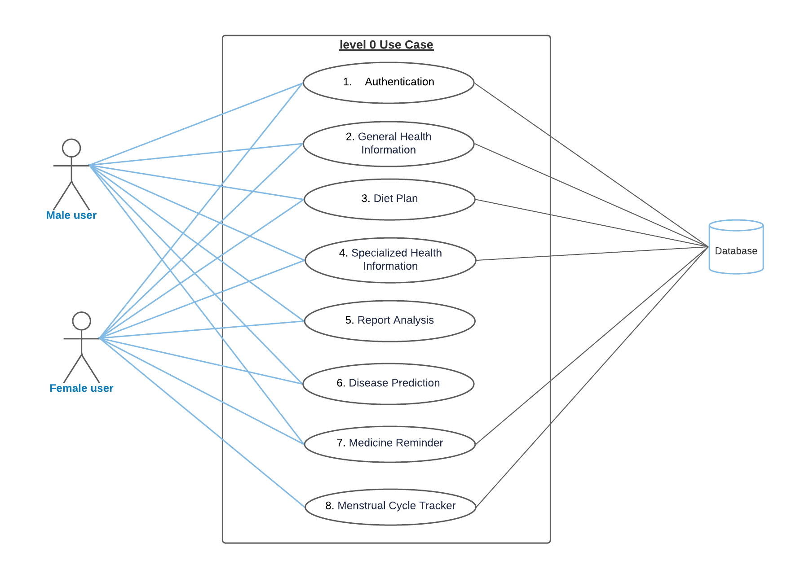
Use Case (Level 0)

Slide 6
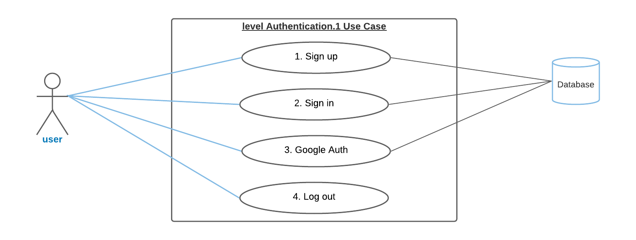
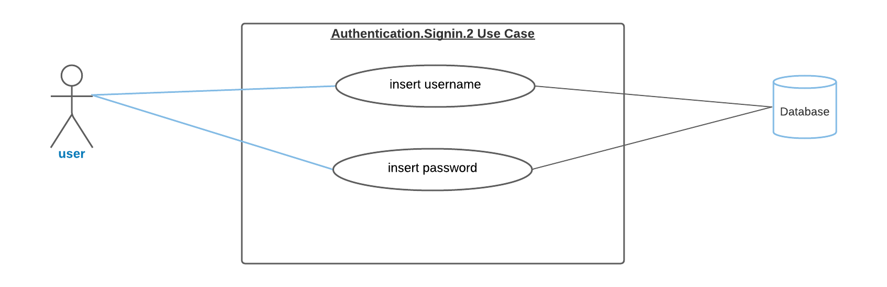
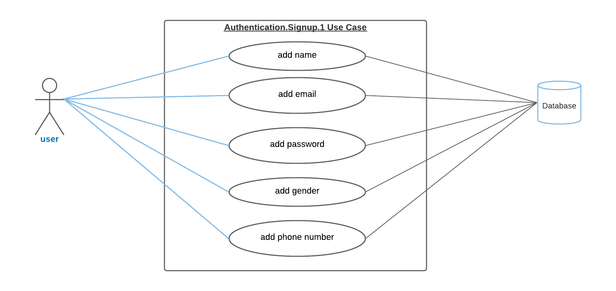
Use Case (Level 1)

Slide 7
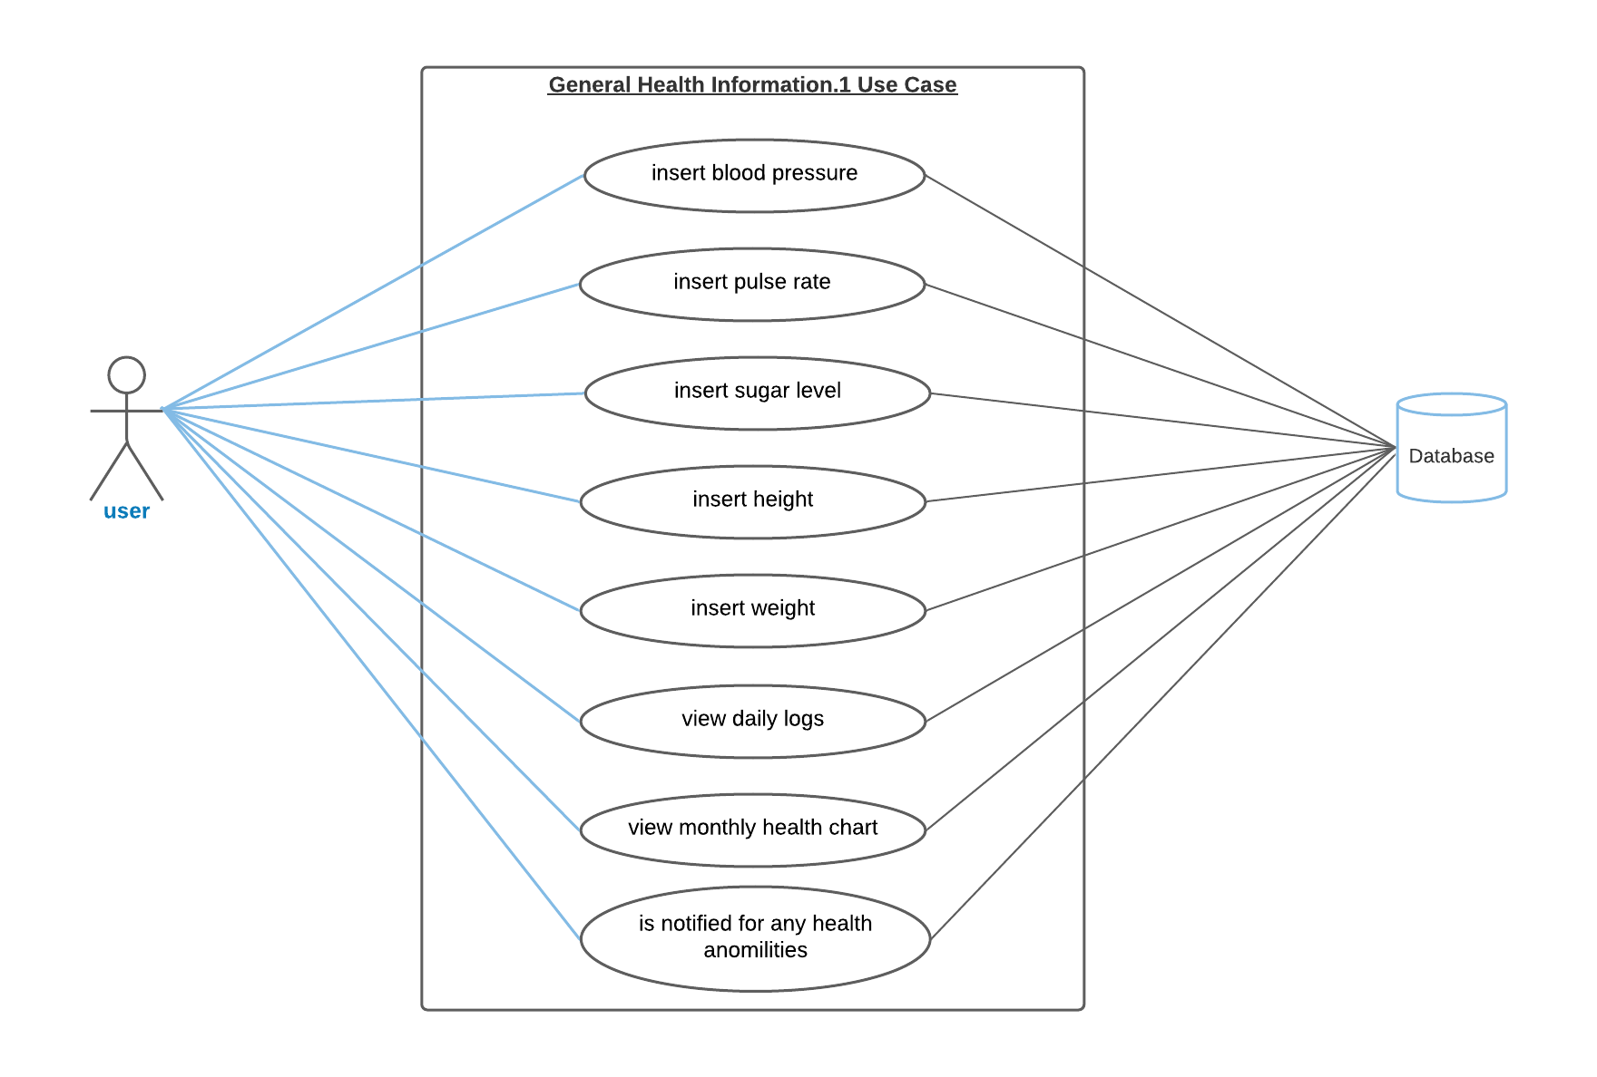
Use Case (Level 1)

Slide 8
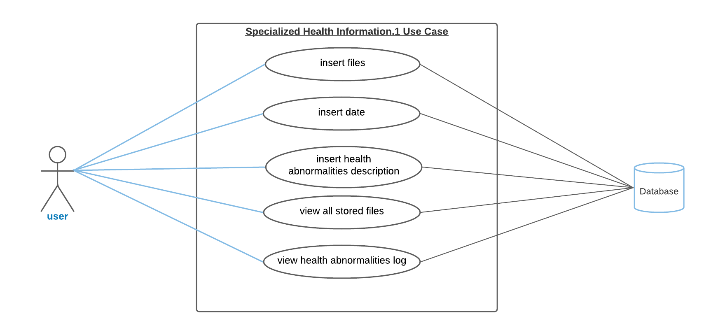
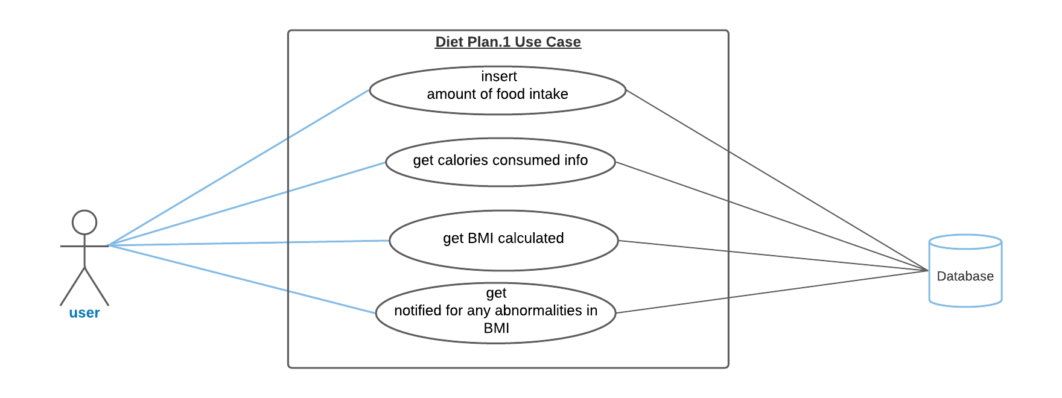
Use Case (Level 1)

Slide 9
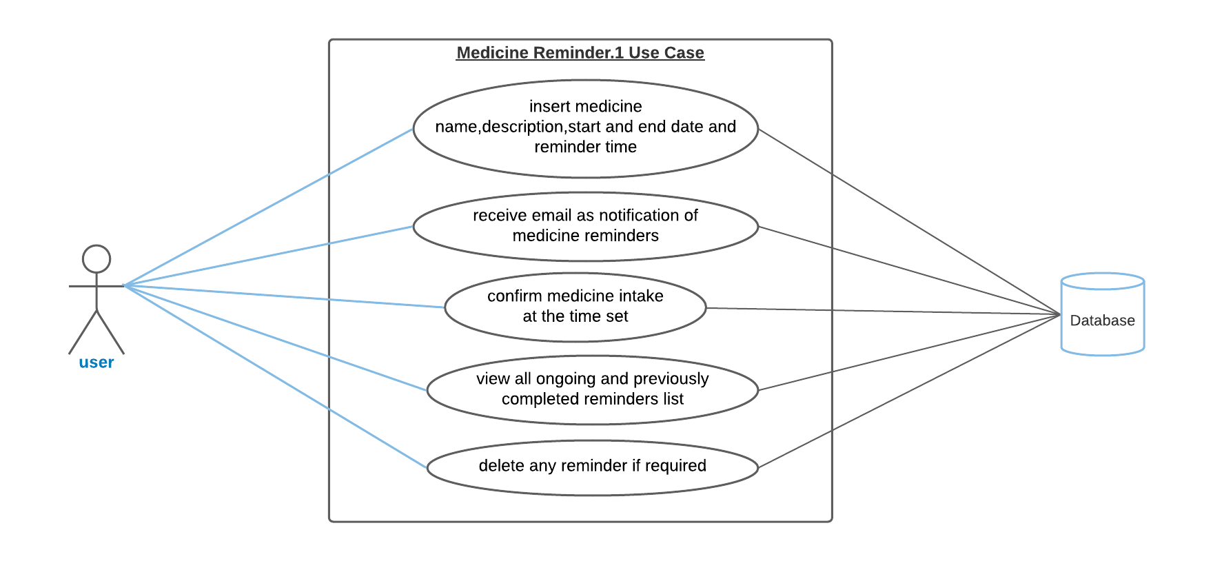
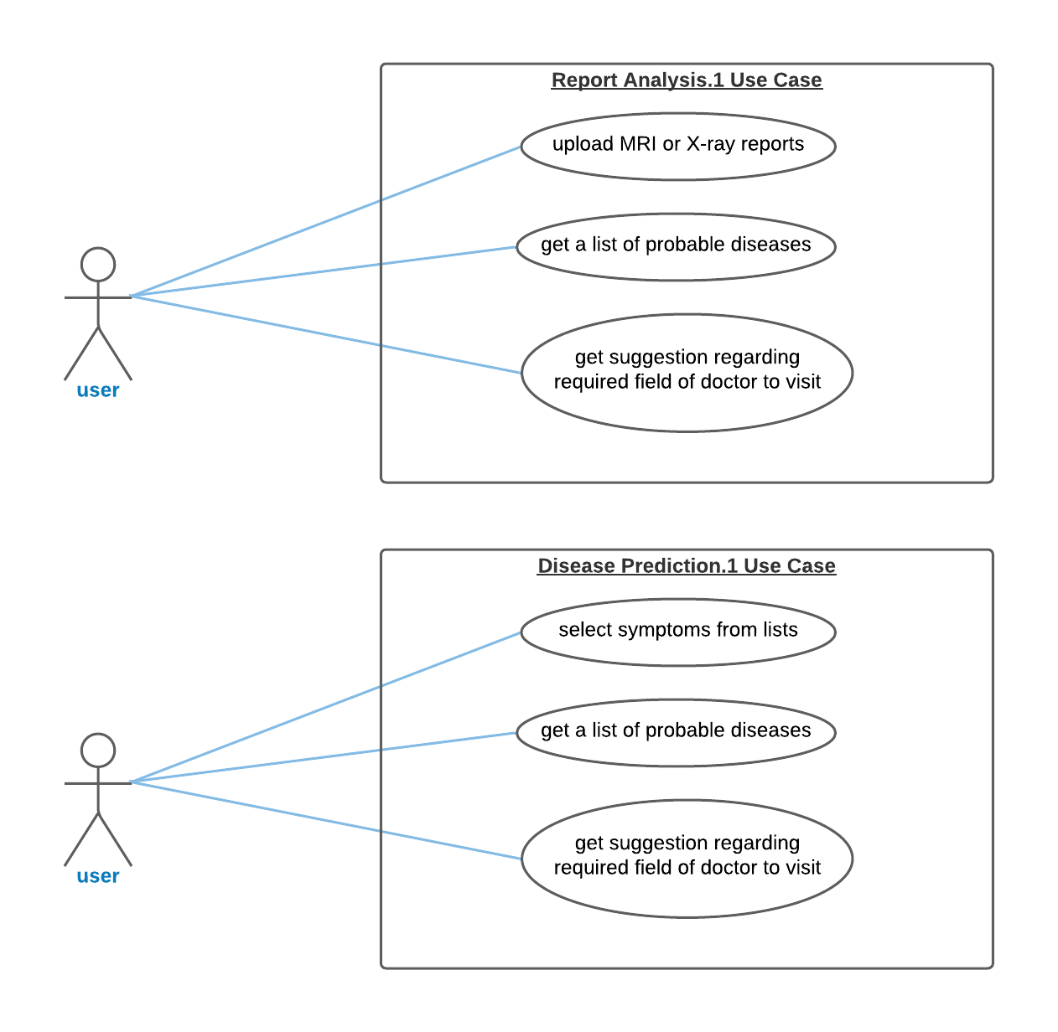
Use Case (Level 1)

Slide 10
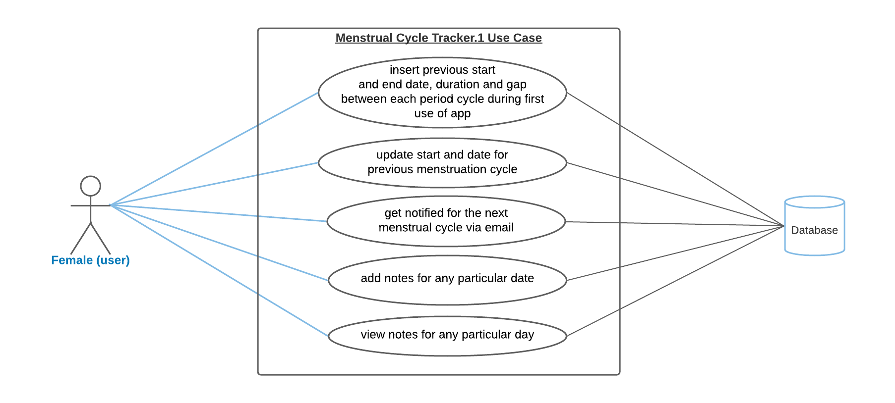
Use Case (Level 1)

Slide 11
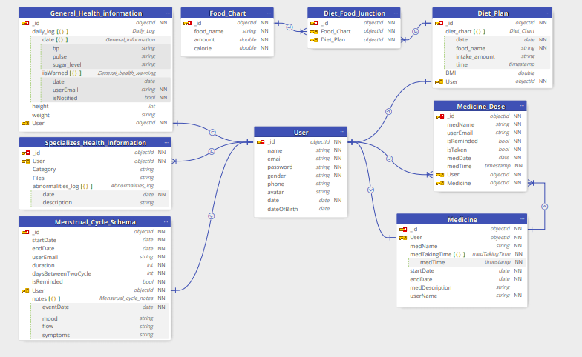
ER-Diagram

Slide 12
The floor is open for Q/A
Thank You!

